Slide 1

Department of Cyber Security
2026-2027- Odd Semester
III Year /V Sem
CS23533-FOUNDATIONS OF ARTIFICIAL INTELLIGENCE
Zeroth Review – 31-07-2026

Slide 2
PROJECT TITLE
Batch Members :
1.Dharani K: 241901025
2.Dhivya M: 241901027
Supervisor:
Dr. S.Bhuvana
^{Assistant Professor[SG]}

Slide 3
OUTLINE
Abstract
Objective
Literature Survey
Summary of Literature
Proposed System & Novelty
Block Diagram
Hardware/Software requirements
References

Slide 4
ABSTRACT
Natural disasters such as floods, fires, earthquakes, and industrial accidents often create
emergency situations where people must evacuate quickly to ensure their safety. During such
events, many roads may become blocked or unsafe, making it difficult to identify a secure
evacuation route. This project proposes an AI-Powered Emergency Evacuation Route
Planning System that assists users in finding the safest path from their current location to a
safe destination during emergencies.
The system applies the A (A-Star) Search Algorithm*, an Artificial Intelligence search
technique, to determine the optimal evacuation route. The road network is represented as a
graph consisting of interconnected locations, where each road is assigned a travel cost. Users
provide the starting location, destination, and blocked roads caused by the emergency. Based
on these inputs, the A* algorithm efficiently explores the available paths and identifies the
safest and most suitable route while avoiding hazardous areas.

Slide 5
OBJECTIVE
To develop an AI-based evacuation route planning system.
To implement the A* Search Algorithm for finding the safest evacuation route.
To avoid blocked or hazardous roads during emergencies.
To reduce evacuation time by selecting an optimal path.
To recalculate the route whenever road conditions change.
To improve public safety during natural disasters.

Slide 6
Literature Survey
TITLE | YEAR | AUTHOR | TECHNIQUE
Route Planning for Emergency Evacuation Using Graph Traversal Algorithms | 2023 | Alexandros Gaitanis, Athanasios Lentzas, Grigorios Tsoumakas, et al. | Floor-plan graph generation + Dijkstra Algorithm
A real-time automatic fire emergency evacuation route selection model | 2024 | Ping Huang, Xiajun Lin, Chunxiang Liu, et al. | Multi-Criteria Decision Making
Help Me Evacuate! A Smart Adaptable Evacuation System | 2023 | Various Authors | Intelligent Route Planning

Slide 7
EXISTING SYSTEM
The existing research paper "Route Planning for Emergency Evacuation Using Graph Traversal Algorithms" uses graph traversal techniques and Dijkstra's Algorithm for finding the shortest evacuation path.
Searches many nodes before reaching the destination.
Higher execution time for large road networks.
Does not use heuristic information.
Less suitable for fast emergency decision making.
Route recalculation may take more time.
Performance decreases as graph size increases.

Slide 8
PROPOSED SYSTEM
The proposed system uses the A Search Algorithm* to calculate the safest evacuation route.
Working:
User enters source location.
User selects destination.
Blocked roads are marked.
Road network is converted into a graph.
A* Search Algorithm calculates the safest route.
Alternative path is generated if a road becomes blocked.
Final safe route is displayed.

Slide 9
Novelty in Proposed System
Real-time hazard-aware routing — blocked/flooded roads are removed from the routing network before A* search.
Dynamic rerouting — hazard changes → safe alternate route automatically generated.
OSM-based real road network — Chennai actual road-network data rather than a fixed sample graph.
Visual hazard representation — 🔴 blocked, 🟠 flood, 🔵 safe A* route directly on the map.
Integrated emergency decision system — location selection → hazard detection → A* routing → visual safe route in one pipeline.

Slide 10
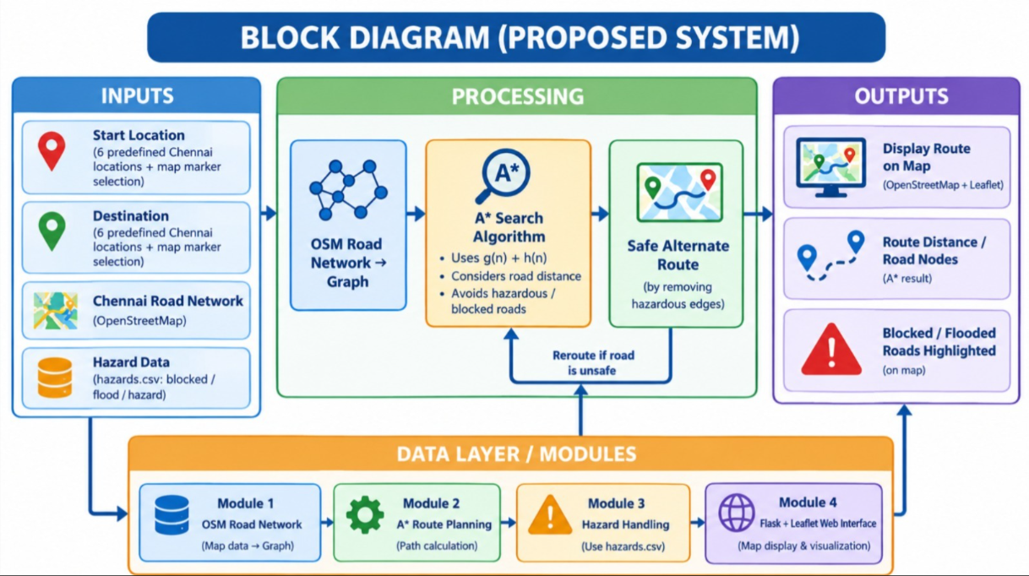
BLOCK DIAGRAM(PROPOSED SYSTEM)

Slide 11
Hardware/Software Requirements
Hardware Requirement:
Processor : Intel Core i3 or above
RAM 4 GB minimum
Storage 20 GB
Free Space Keyboard & Mouse
Software Requirement:
Operating System : Windows 10/11
Programming Language : Python
IDE : Visual Studio Code / PyCharm
Libraries : NetworkX, Matplotlib
Version Control : Git (Optional)

Slide 12
References
[1] Gaitanis, A., Lentzas, A., Tsoumakas, G., & Vrakas, D. (2023). Route Planning for Emergency Evacuation Using Graph Traversal Algorithms. Smart Cities, 6(4), 1814–1831. https://doi.org/10.3390/smartcities6040084
[2] Lakshay, Agarwal, A., & Bolia, N. B. (2016). Route Guidance Map for Emergency Evacuation. Journal of Risk Analysis and Crisis Response, 6(3), 135–144. https://link.springer.com/article/10.2991/jrarc.2016.6.3.3
[3] Han, Z., et al. (2013). Integrated Evacuation Route Planning Based on Real-Time Data Acquisition.
[4] Liu, J., Rojas-Cessa, R., & Dong, Z. (2016). Sensing, Calculating and Disseminating Evacuating Routes During an Indoor Fire.

